Slide 1

Outcomes After Revision TKA for Flexion Instability
vs Flexion Instability with Arthrofibrosis
The Journal of Arthroplasty (2025)
Christopher F. Deans, MD , Payton K. Arnold, MD , Evan R. Deckard, BSE , R. Michael Meneghini, MD .
Department of Orthopaedic Surgery, Nebraska Medical Center, Omaha, Nebraska
St. John Surgical Residency, Ascension St. John Hospital, Detroit, Michigan Indiana Joint Replacement Institute, Indianapolis, Indiana
Department of Orthopaedic Surgery, Indiana University School of Medicine, Indianapolis, Indiana
Panuwat Silawatshananai, MD (Dr.Max) Bangkok International Hospital, Bangkok, Thailand

Slide 2

Introduction
Flexion instability (FI) is a major cause of early TKA failure.
Resulting from mismatch between flexion and extension gaps
Arthrofibrosis (A) is characterized by excessive scar formation
causes stiffness and reduced knee motion
A subset of patients present with a paradoxical combination: FI + arthrofibrosis (FI + A).
Knowledge gap: No prior study compared revision TKA outcomes between isolated FI and FI + A.

Slide 3

Study design
Retrospective review of 669 revision TKA cases
Revision TKA cases performed by four surgeons at a single academic institution (Sept 1, 2012 – Dec 31, 2019).
115 FI cases and 20 FI + A cases were identified
Demographics and PROM-related data were extracted from standardized EMR history and physical examinations.

Slide 4
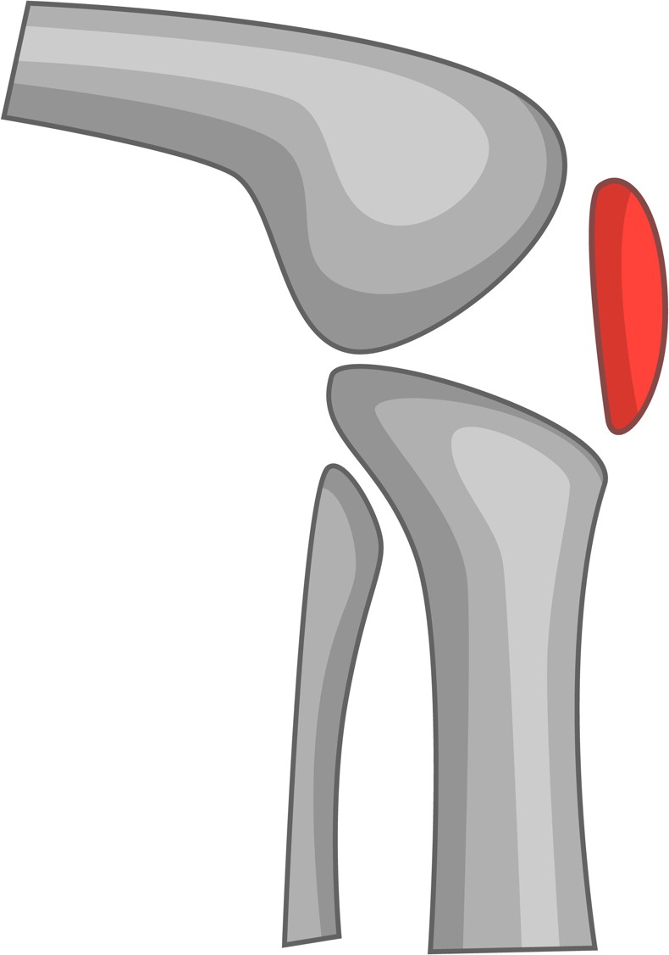
Clinical Diagnostic Criteria
Arthrofibrosis defined by functional limitation and ROM thresholds: flexion contracture ≥10°, flexion ≤95°, or arc ≤70°.
FI + A suspected when ROM decline plus radiographic signs (undersized/distalized femur, ↓ posterior offset, ↑ tibial slope).
Physical exam often limited by stiffness and guarding.
FI confirmed intraoperatively by >3–4 mm increased flexion gap vs extension gap.

Slide 5
Surgical Technique
Followed Abdel’s algorithm for revision of flexion instability.
Performed full exposure with synovectomy, scar excision, and careful implant removal.
Corrected mechanics by neutralizing tibial slope, slightly elevating joint line, and
restoring posterior femoral offset (often upsizing femoral component).
Confirmed balance using flexion–extension gap assessment; used VVC polyethylene; patella resurfaced only if previously unresurfaced.
PROMs (UCLA, KOOS-JR, KSS, satisfaction), radiographic parameters, and ROM were measured pre-revision and post-revision using standardized scoring systems and X-ray protocols,

Slide 6
Demographic and Comorbidity Comparison.

Slide 7
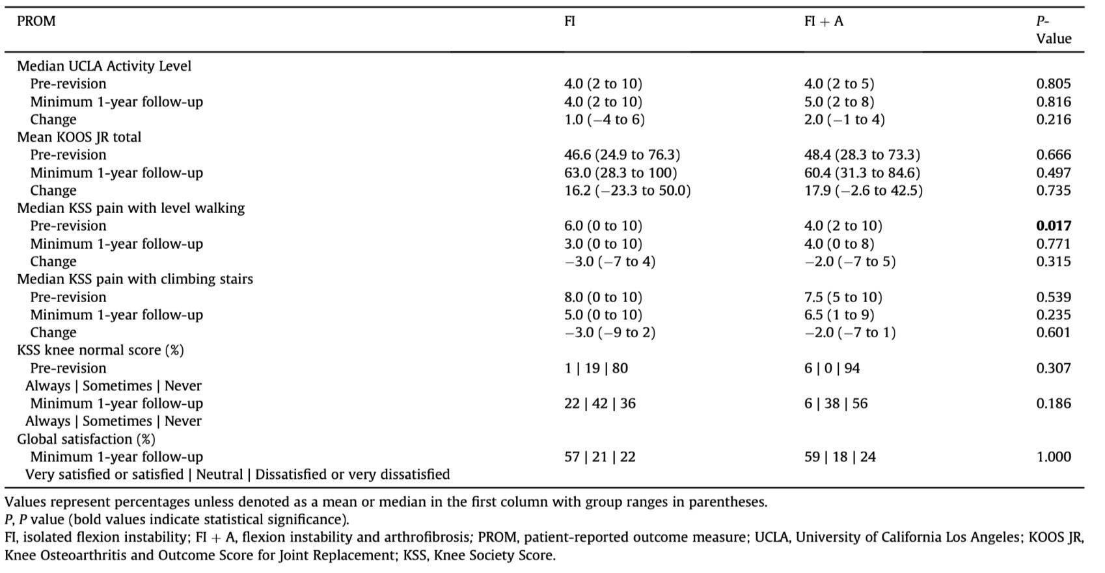
Results : PROMs & Functional Outcomes
No significant differences in PROMs (UCLA, KOOS-JR, KSS, satisfaction) between FI and FI + A groups at ≥1-year follow-up.

Slide 8
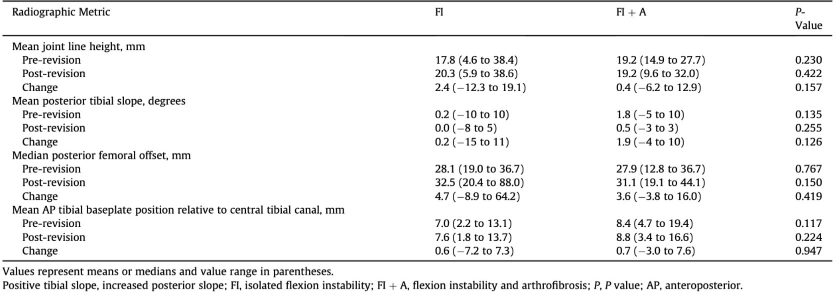
Results : Radiographic Measures
No differences in joint line height, posterior tibial slope, posterior femoral offset, or tibial baseplate position pre- or post-revision

Slide 9
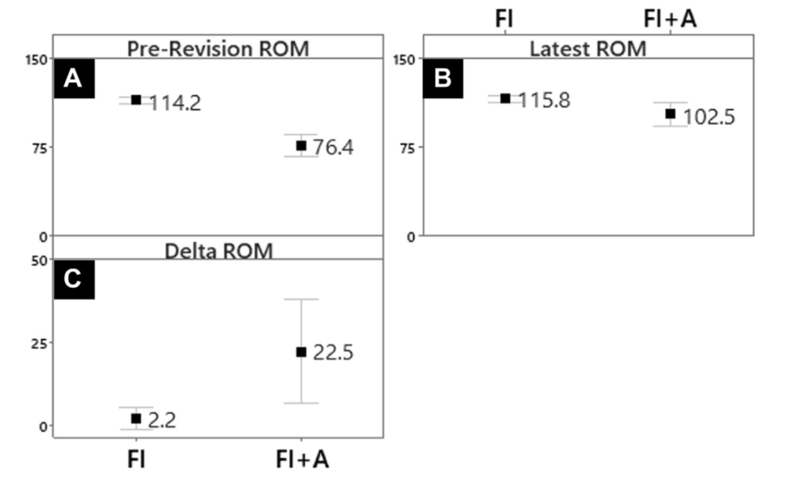
Results : Range of Motion
FI + A group had a greater ROM improvement

Slide 10
Discussion
FI + Arthrofibrosis showed the largest ROM improvement (~23°)
Despite starting with severe stiffness, and ultimately achieved
similar functional outcomes to isolated FI.
Diagnosis of FI + A remains challenging
o accurate identification requires radiographic evaluation + intraoperative gap assessment to confirm mechanical causes.
Findings suggest that instability can drive secondary arthrofibrosis, and correcting mechanical errors (offset, slope, joint line) during revision TKA is essential for durable recovery.

Slide 11

Take Home Message
Revision TKA for FI + Arthrofibrosis provides comparable functional outcomes to isolated FI, with the added benefit of significantly greater ROM improvement.
Correcting mechanical factors
joint line, tibial slope, posterior femoral offset
Appears critical in reversing stiffness and preventing recurrent arthrofibrosis.

Slide 12








Thank you!
LEARN – PRACTICE - PERFORM
www.practicalcourseorthopedics.com

