Slide 1

The CCJR® Charles A. Engh, Sr, MD. Excellence in Hip Research Award: Pelvic Tilt and Cup Position Change Significantly in Most Young Patients 10 Years after Hip Arthroplasty
The Journal of Arthroplasty 40 (2025)
Joseph J. Kromka, MD, William A. Zuke, MD, Caroline J. Granger, MD, John C. Clohisy, MD, Robert L. Barrack, MD | Department of Orthopaedic Surgery, Washington University School of Medicine, Barnes-Jewish Hospital, St. Louis, Missouri
26 March 2025
Panuwat Silawatshananai, MD (Dr.Max) Bangkok International Hospital, Bangkok, Thailand

Slide 2

Introduction
Cup orientation drives biomechanics
Impingement, edge-loading, wear, instability
spinopelvic alignment/mobility dictates the functional cup position beyond static intra-op placement.
Degenerative sagittal changes (loss of lordosis, stiffness/fusion)
progressive posterior pelvic tilt, yielding functional ↑anteversion/↑inclination over time.
Aim: quantify ≥10-yr pelvic tilt trajectories in younger THA/SRA patients and the resulting Δ functional version/inclination crossing clinically meaningful thresholds.

Slide 3
Study design
Retrospective cohort, single academic hip practice
Procedures: Total Hip Arthroplasty (THA) or Surface Replacement (SRA)
Inclusion: index age 45–60; ≥10-year radiographic follow-up
Cohort: N=200 split into 45–50 (n=100) vs 55–60 (n=100)
Mean follow-up ≈13 years; films acquired in a consistent position (mostly supine AP pelvis)

Slide 4
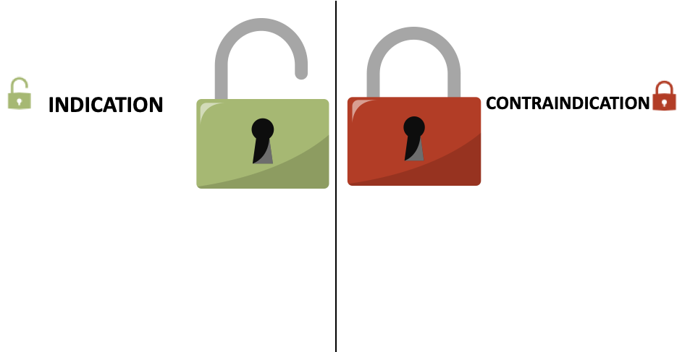
Study design
Exclusion Criteria
Inclusion criteria
Primary THA/SRA at the study center
Pre-op and ~10-yr AP pelvis films in the same position
Index age 45–50 or 55–60 years
Missing 10-yr follow-up films
Position mismatch between baseline and follow-up films
Inadequate image quality for measurements

Slide 5
Methodology
Measure pelvic ratio on standardized AP pelvis radiographs
Convert pelvic ratio → Pelvic Tilt (°) via validated formulas
Map ΔPT → Δ functional anteversion & inclination using published nomograms
Clinically meaningful change pre-defined as >5° (either parameter)
Subgroup: patients who later underwent spine surgery

Slide 6
Results
Mean ΔPT = −9.87° (posterior), p<0.001
Estimated functional change: +7.90° anteversion, +1.97° inclination
62.5% exceeded the >5° meaningful threshold
Age effect: 45–50 group ΔPT −11.5° vs 55–60 group −8.25° (p=0.024)
Spine-surgery subgroup showed larger PT shifts (trend)

Slide 7
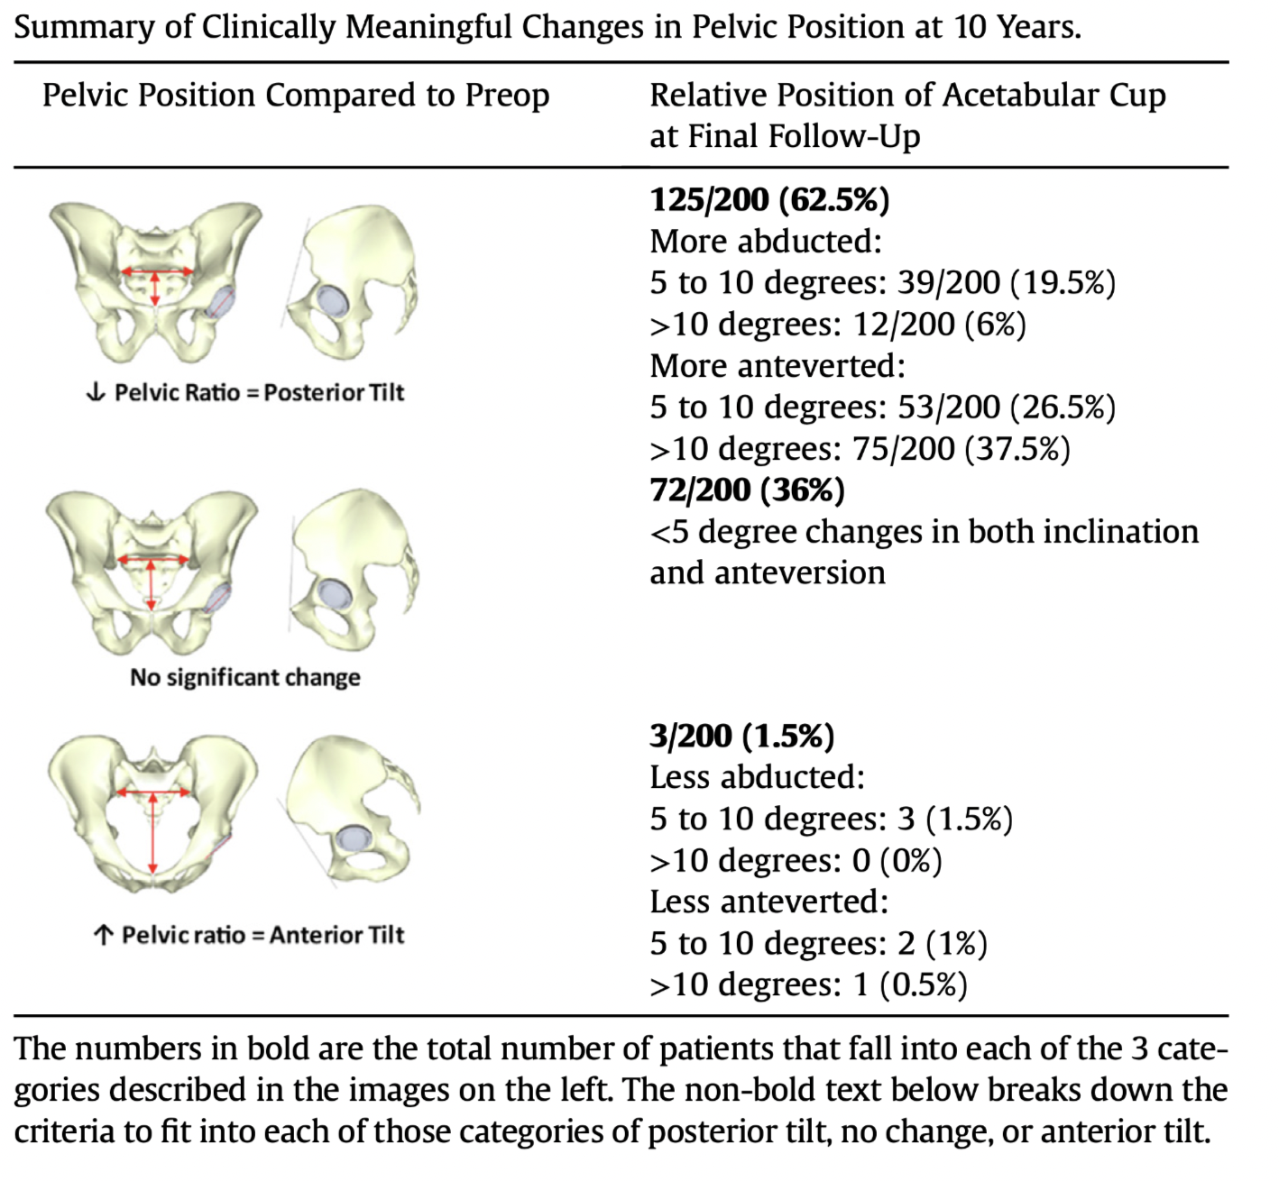

Slide 8
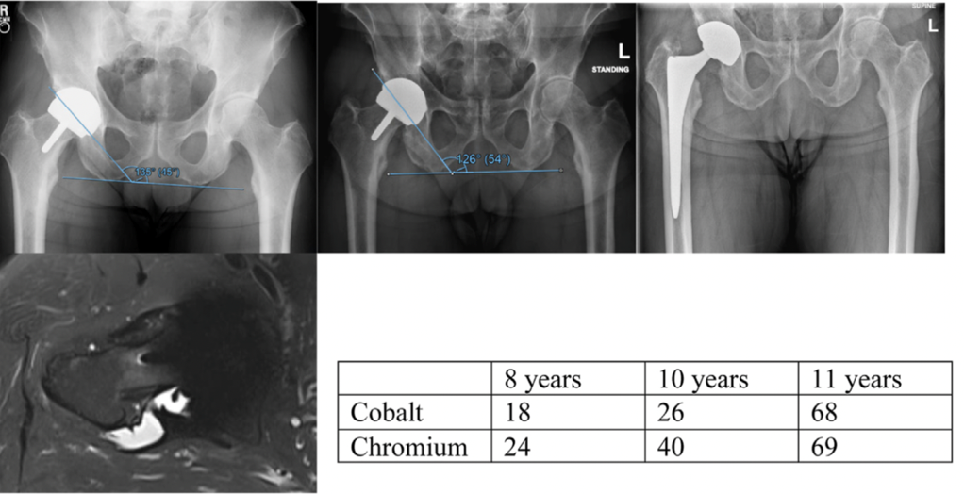
Patient with previously well-functioning SRA who developed late elevation in metal ions and pseudotumor with an increase in pelvic tilt over time (inclination from 45 to 54 degrees).

Slide 9
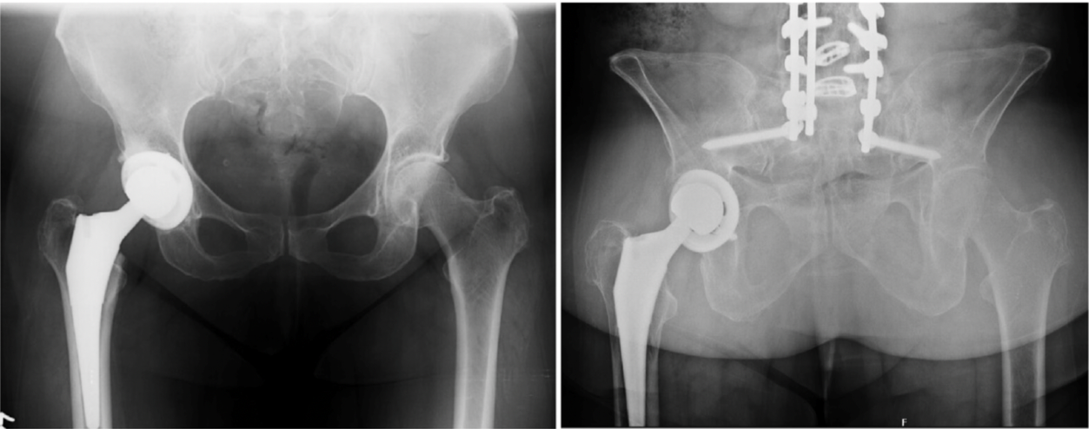
Patient with profound acetabular cup functional position change over a 10-year period with change in pelvic tilt of 92 degrees.

Slide 10
Discussion
Functional drift: Over ~10 years, progressive posterior pelvic tilt makes the acetabular component functionally more anteverted (≈+8°) and slightly more inclined (≈+2°), even when intra-op placement was “ideal.”
Who’s at risk: Younger index age (45–50) shows greater PT drift; prior/interval lumbar surgery may amplify changes → narrower impingement/wear margins and potential late instability.
Limitations Retrospective, single-center; PT from AP films with estimated (non-EOS/CT) functional angles; heterogeneous THA/SRA; no dislocation/wear outcomes.

Slide 11
Discussion
Functional orientation drifts with aging/posture → late instability & edge-loading risk can rise
Preop: obtain standing/sitting lateral or consistent-position imaging to document PT/mobility
Intraop: in younger/flexible spines, bias cup toward the lower end of the functional safe zone
Follow-up: Counsel young/active patients; use symptom-based surveillance (click/catch/squeak).
Spine–hip: Lumbar fusion may amplify changes—coordinate with the spine team.

Slide 12





